Slide 1

Machine learning for the purpose of Predicting Insurance claims
Christian Bam

Slide 2

“machine learning ~ monkey see, monkey do.”
― Andrew W. Trask,

Slide 3
Timeline
Cleaning and visualization
Exploratory Data Analysis
Explanatory Data Analysis
Modeling
Built models and improved on them until the model was at it’s peak accuracy.
Delete unnecessary columns and duplicate rows.
Corrected inconsistencies in data.
Identified and addressed missing values.
Identified outliers.
Produced univariate visuals for the target and all features.
Show Correlation between target and features
Use univariate visualization to show the distribution of values/categories

Slide 4



Agenda
Stakeholder and problem
introduction to data
visuals and key findings
strengths and limitations
Recommendations

Slide 5




Stakeholder and problem
The stakeholder is car insurance section of Momentum.
Since premiums are calculated according to risk, a model that predicts the likelihood of clients claiming will help determine the appropriate premiums per client.

Slide 6
Car Insurance Data
Reason for use
features
The data we are using is from Kaggle, it is real world data which means are model is applicable to real world applications.
Each record is on a client level, this is good as our use case is to look on a client level
The data has 18 features we can use to determine chance of claiming, this is a good number as for car insurance our model does not have to be too complex
There are 10000 records, this is more than enough data to help train our model

Slide 7

Visuals
Subtitle

Slide 8
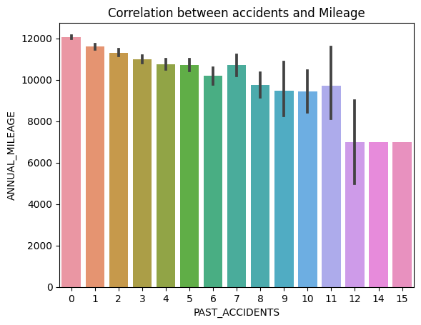
Chart 1 – Correlation between accidents and mileage
This graph indicates the correlation between accidents and annual mileage. We can see from this graph that the more accidents the person has the lower their mileage.
This is helpful as we would assume the higher the mileage the higher the change of accidents and therefor a higher chance of claiming.
This graph shows me that people who are not good drivers will both have more accidents and drive less since they are not good drivers

Slide 9
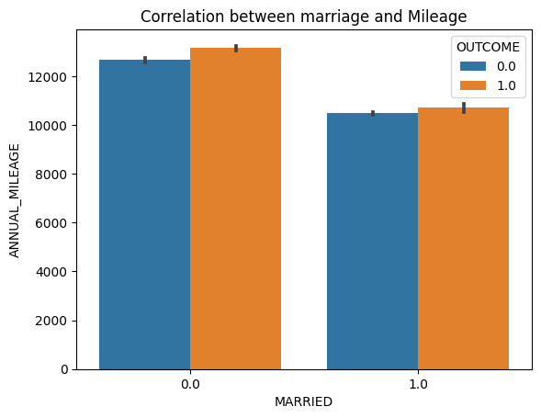
Chart 1 – Correlation between marriage and mileage
This graph shows that when the customer is married, they tend to have far less mileage, I chose this visual as I believe it is a key role-player in the outcome. I believe it correlates to the outcome as married people have family responsibilities and will drive safe since they have another person's life to consider when driving.

Slide 10
strengths and limitations
strengths
limitations
Recommendations
My model makes use of Principle Component Analysis , this ensures that the model trains faster by using Dimensionality reduction. Dimensionality reduction is a type of feature extraction technique that aims to reduce the number of input features while retaining as much of the original information
My model has an 85% accuracy. Considering accidents are difficult to predict as they are also influenced by factors that we cannot control, I believe this is a good score.
Although 85% is a good score, we must consider that there will be a small number of false negatives and positives which will lead to potentially undercharging clients.
Regarding the predictions of this model, due to the slight chance of False negatives, I would charge the clients with a higher risk a slightly higher premium to make up for it

Slide 11

Summary
This is still a work in progress, will fix before presentation

Slide 12


Thank You
Christian Bam
Christianmatthewbam@gmail.com
https://www.linkedin.com/in/christian-bam/

